Slide 1
Travel-A-Pic
Photo Traveller – Use case

Slide 2
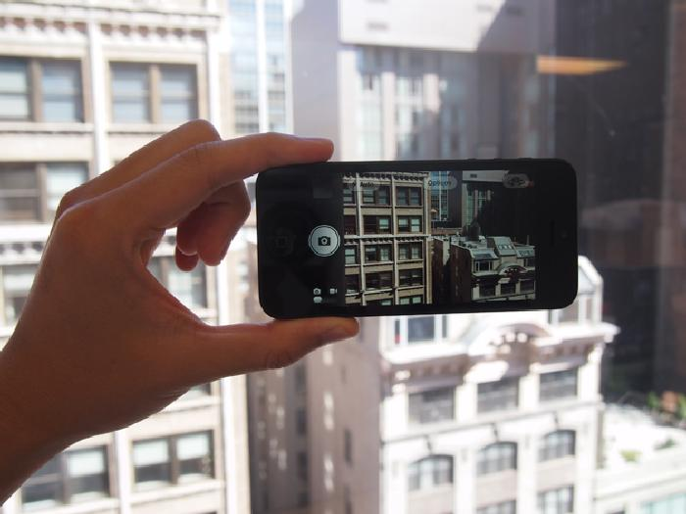
Tim looks at a picture in a magazine/facebook which interests him as a potential place for travel.
He takes his device and points it at the pic and the app finds the travel destination to be “Singapore”.

Slide 3
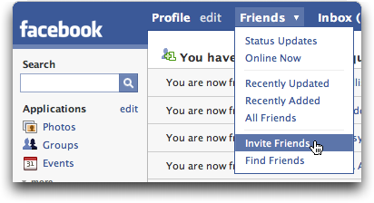
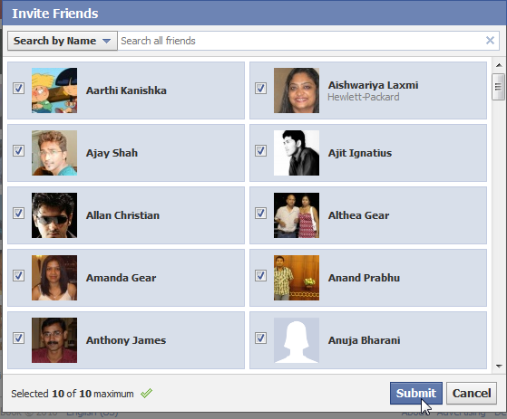
Tim is quite excited with idea of visiting Singapore, he invites his “facebook friends” to accompany for the trip.

Slide 4
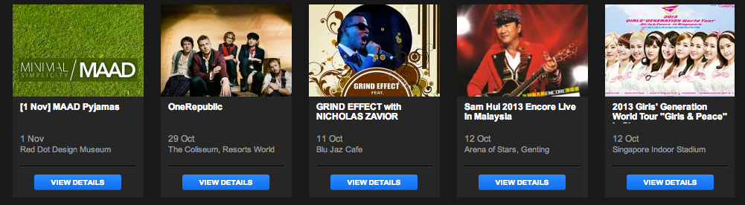
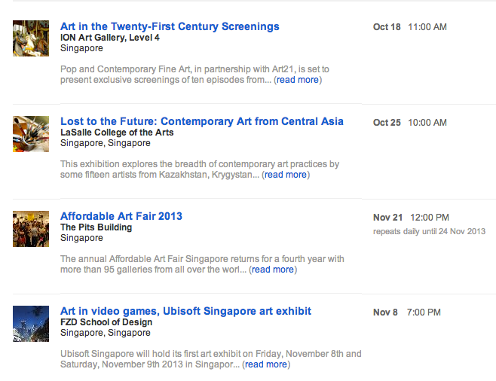
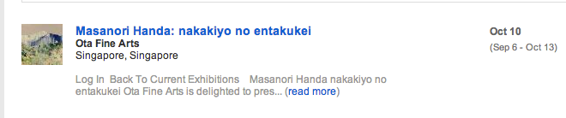
Dorothy, Kevin and Erica agree to accompany for the trip.
After the location and members are finalized next comes “Planning”.
Dorothy and Erica are passionate about art where as Tim and Kevin are passionate about Music.
The app suggests “places/events” based on individual “interests” in Singapore which helps in a better, efficient and quick planning for the trip.

Slide 5

The app, “knowing” the location of Tim and co., also finds them a great flight deal to “Singapore”.
It also suggests the accommodation options, the places around their stay, the commutation and other required information.

Slide 6
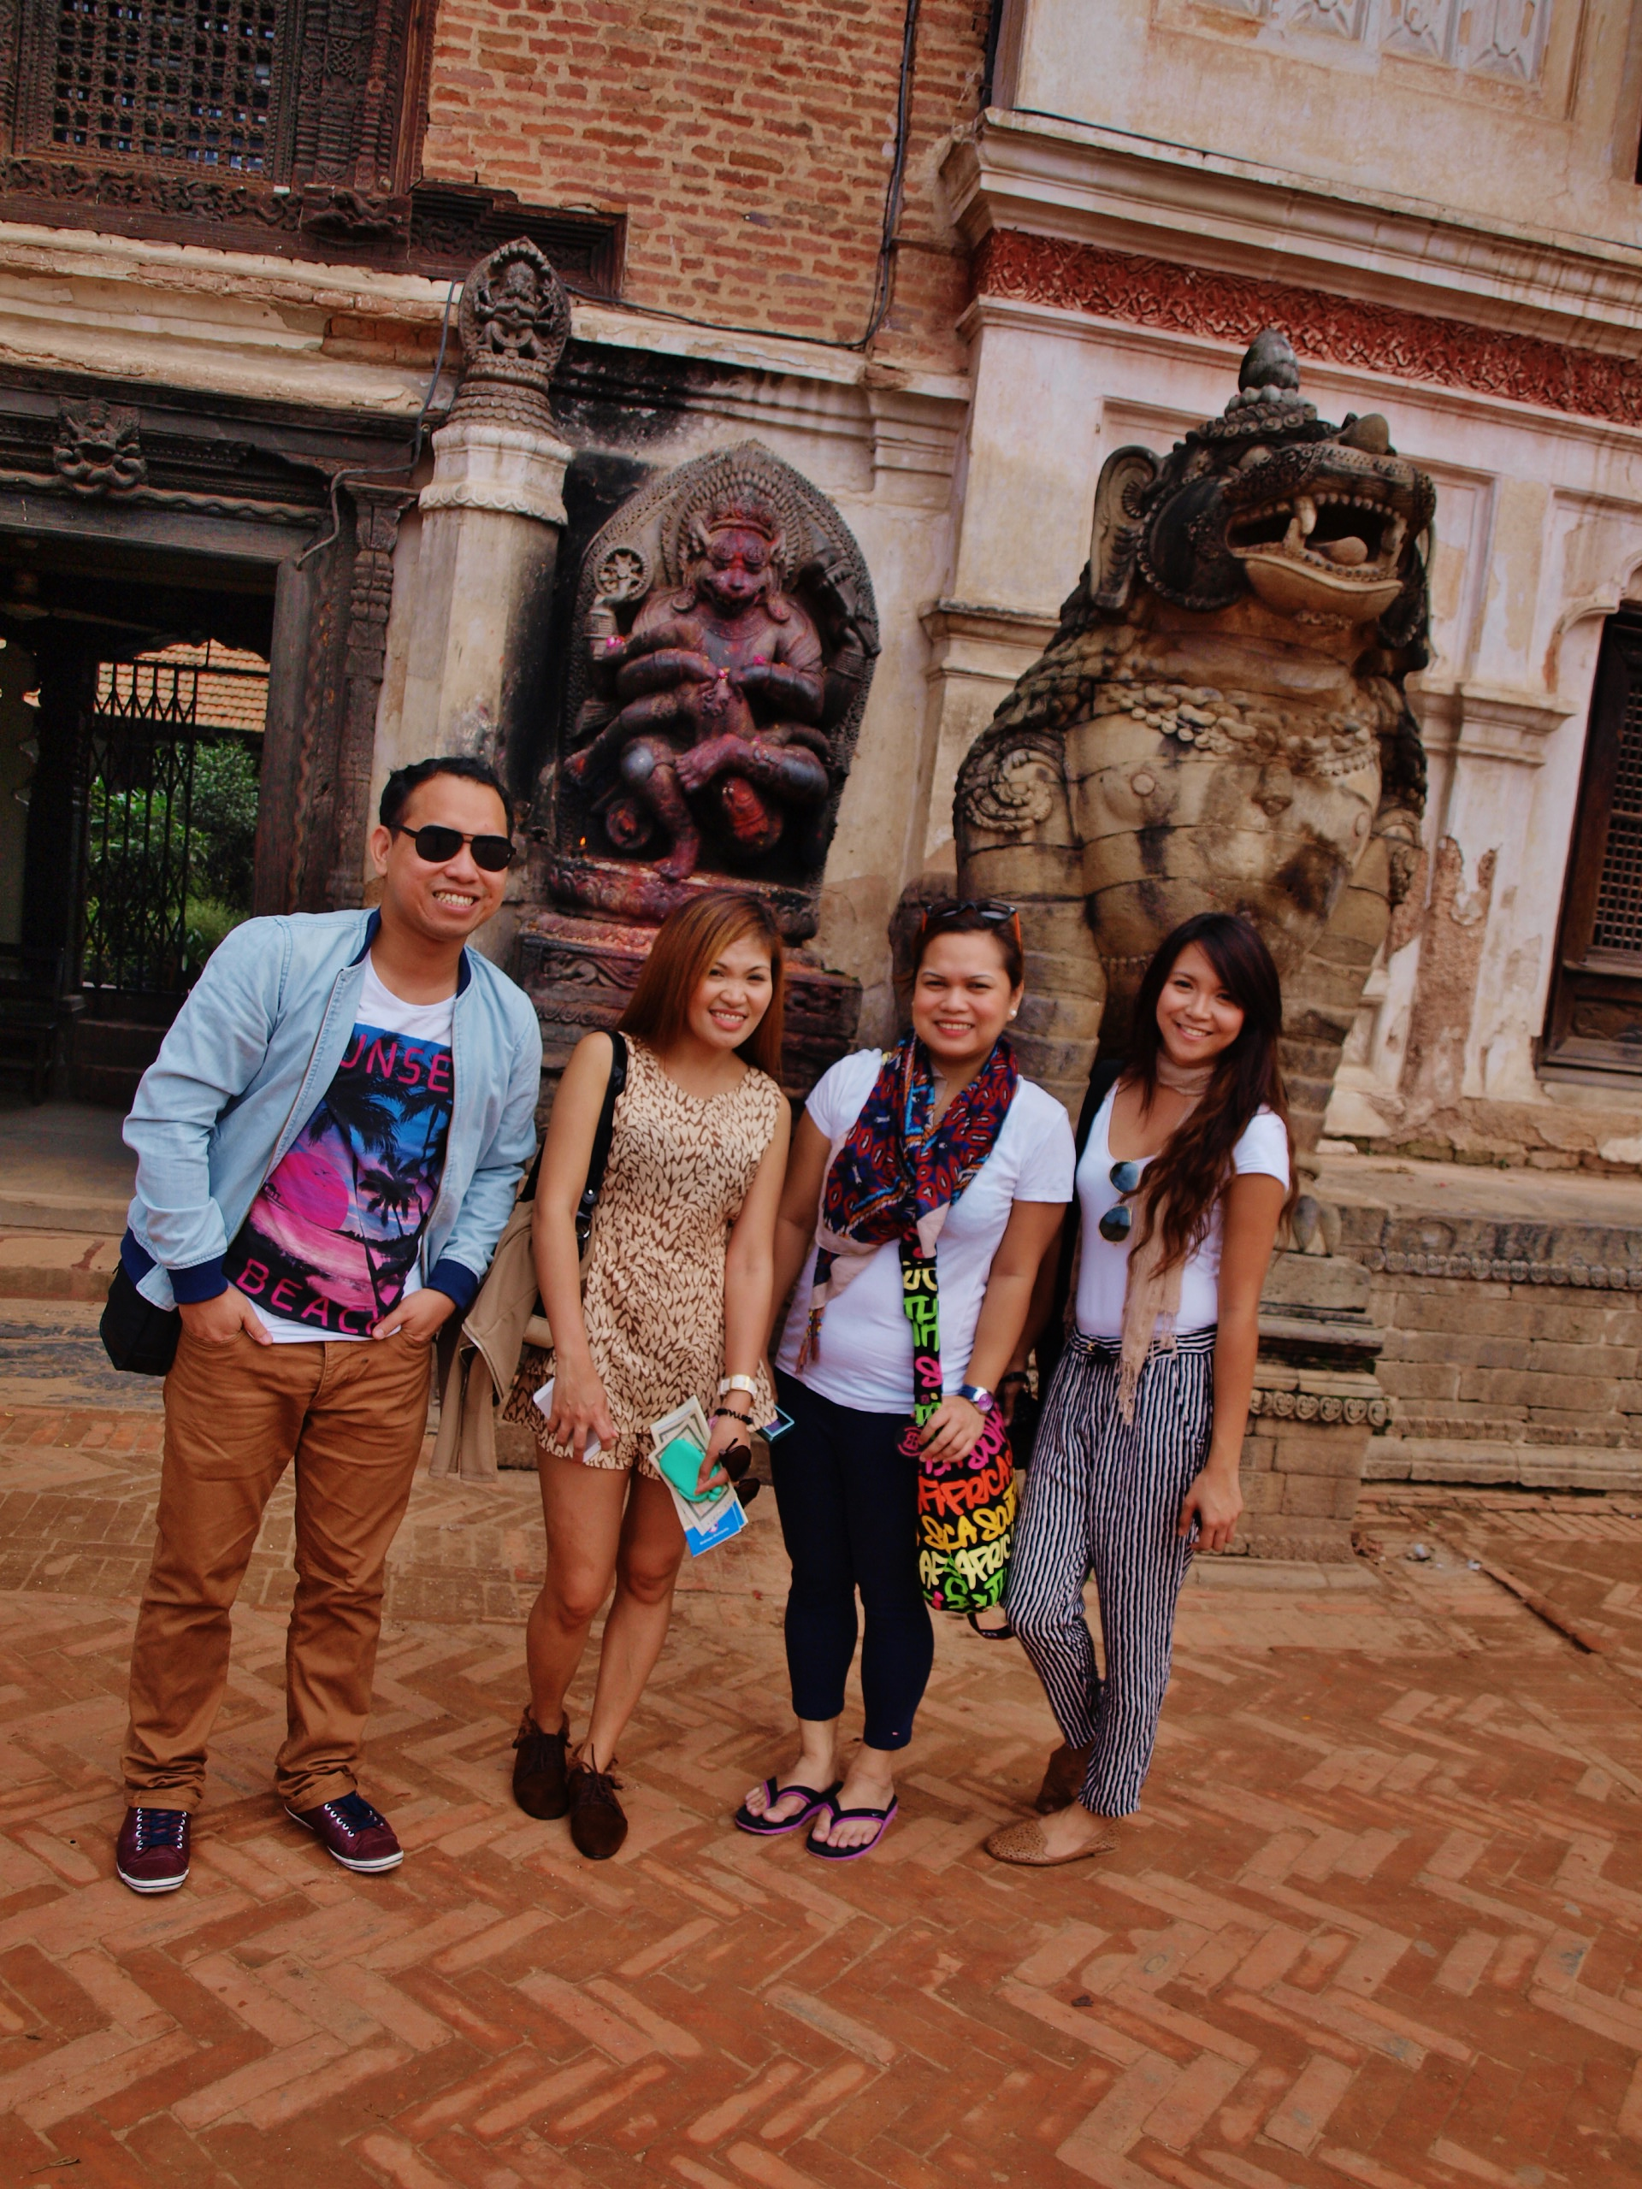
The trip is confirmed and tickets booked.
The trip automatically added to the calendar.
Digital tickets saved into their devices.
And all services set up to notify them with the travel updates.

Slide 7
Thank You ☺

